Slide 1
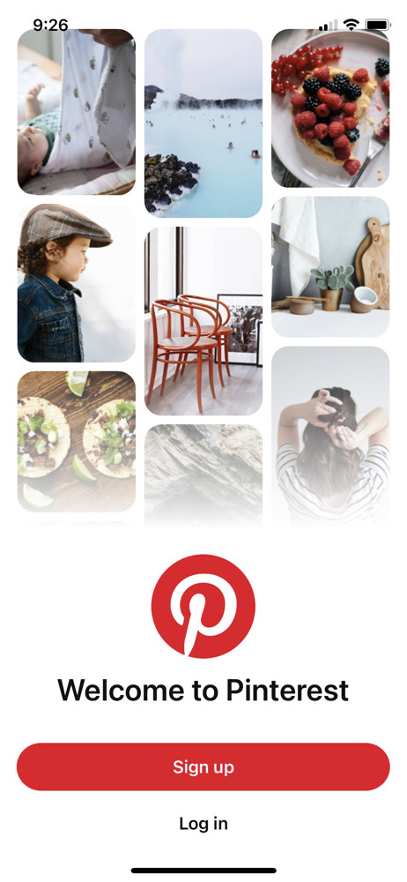


8.2%
Market share
valued at 26.81 billion USD
14.9%
Social media visits owned by Pinterest
85%
A brief deep dive on a popular yet underrated social media app
of weekly users have made a purchase from Pinterest pins
96%
of top Pinterest searches are unbranded
85%
of Pinners say Pinterest is where they go to start a new project
80%
of weekly Pinners have discovered a new brand or product on Pinterest

Slide 2


Pinterest Vision
“To inspire people to create a life they love by fulfilling their needs, desires, and dreams through visual discovery.”
Pinterest's vision is to help people discover and do what they love.
By providing an inspirational platform that enables people to find their passions, Pinterest aims to empower users to pursue their dreams and build lives they love.

Slide 3




Pinterest Mission and User Goals
"To bring everyone the inspiration to create a life they love"
Global Community
Connect People Through Shared Interests
Billions of Users
Reveal Common Links
Every Pin is a possibility
Right Audience.
Right Place
Right Time

Slide 4
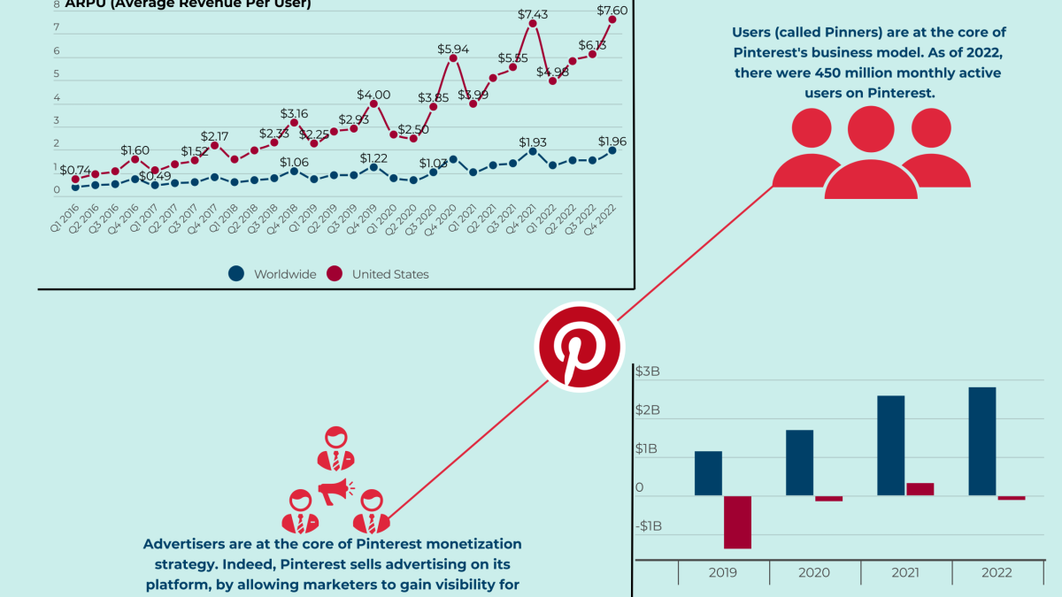
Product Strategy
VISION
CONSTRAINTS
TRADE-OFFS
UNIQUE ACTIVITIES
CAPABILITIES & SYSTEMS
SUPPORTING SYSTEMS
Inspiration is more urgent than ever before—for consumers and brands.
Foster creativity
Connect people with shared interests
Discovery and decision-making
Budget – for new features
Time – with the rapid evolution of technologies and competitor landscape
Balancing resources – internal talents across different platforms
Technology evolution – upgradation requirement
Personalization vs Privacy
Content Diversity vs User Engagement
Monetization vs User Experience
Inclusivity vs Stereotyping
Algo bias vs Content Quality
Long-term sustainability vs Short-term Engagement
Target the right audience – homemakers of the Midwest
Listen to the users
Make it familiar
Focus on visual search
Share ideas and not just create
Image and Video sharing
Visual Search
Board creation
Following, Likes, and comments
Shopping
Ads
Machine Learning Models
Content Distribution Infrastructure
Data Processing/Management
Experimentation
Cloud
Supported Languages
Core Client Platform
API
MARKET
VALUE PROPOSITION
GROWTH & MARKETING
KEY METRICS
ASK YOURSELF
Demographics – age, gender, location
Interests: Visual Inspiration, Lifestyle, Business and Education, Hobbies, Planning and Decision-making, Community
Online behavior
Expansion based on diversity
For Businesses
For Advertisers
For Influencers
For Innovators
For Buyers
For Idea Finders
Visual Appeal Focus
Word of Mouth and Virality
SEO and Content Marketing
Partnerships and Influencer Marketing
Community Building
Mobile Optimization
Data-driven approach
Monthly Active Users (MAU)
Engagement rate
Retention Rate
Conversion Rate
Revenue Per User (ARPU) - $2/user
Differentiating unique features from competitors?
Do all the elements and components align with the company’s goals and vision?
What assumptions were made on user behavior, market trends, and technology need to be true?
Is the strategy scalable/sustainable?
How well are the target’s needs and preferences are addressed?

Slide 5

9
Roadmap
(2009 to Present)
2024:
Feature Release:
Pinterest Predicts
Paid Partnership: Target (2017) and Amazon (2023)
8
Geographical expansion- Jumpstart Program (2015)
6
7
2012:
Promoted Pins
2017:
Feature Release: Lens and Instant Ideas
4
Value: $11B
5
2010:
Invite only open-beta launch to public.
2014:
Feature Release:
Guided Search and Custom categorization
2
3
2011:
iOS and android releases
2009: Customer behavior analysis of Tote, Prototype development and closed beta test.
1

Slide 6
Funding and Monetization
Funding rounds
Advertising and Shares
2023 Financials
Jan 2010 – $500k Angel round
May 2011 – $10M Series A
Oct 2011 – $27M Series B
May 2012 – $100M Series C
Feb 2013 – $200M Series D
Oct 2013 – $225M Series E
May 2014 – $200M Series F
Promoted PINS: $0.00 – $0.10 per click, $2.00 per conversion, $0.00 – $1.50 per 1000 impressions
2019: IPO $19 per share and it raised $1.4 billion
Dec. 26, 2022: market capitalization of $16.6 billion.
Revenue: $3055M (grew 9% YoY).
Income Loss: $35.61M.
Adjusted EBITDA was $683M for 2023 (22% margin).
Operating profit margin is 3.65%.
Net profit margin is -1.17%.

Slide 7







Competitor Landscape
E-commerce
Explore Brands
Other platform for niche needs
Marketplace
Dynamic feed &
Updated trends
Better personalized algorithm &
Targeted Ads

Slide 8
01
B2C App
Can bring end user perspective
02
Pain points
Identified more room for improvements by identifying pain points
The big why ?
We simply love pinning !!!
03
Product enhancements
New feature recommendations based on user problems.
Purge unused features.
04
Free thinking & Product relevance
Identified multitude of opportunities for free thinks without much constrictions
To bring better product relevance among existing users

Slide 9
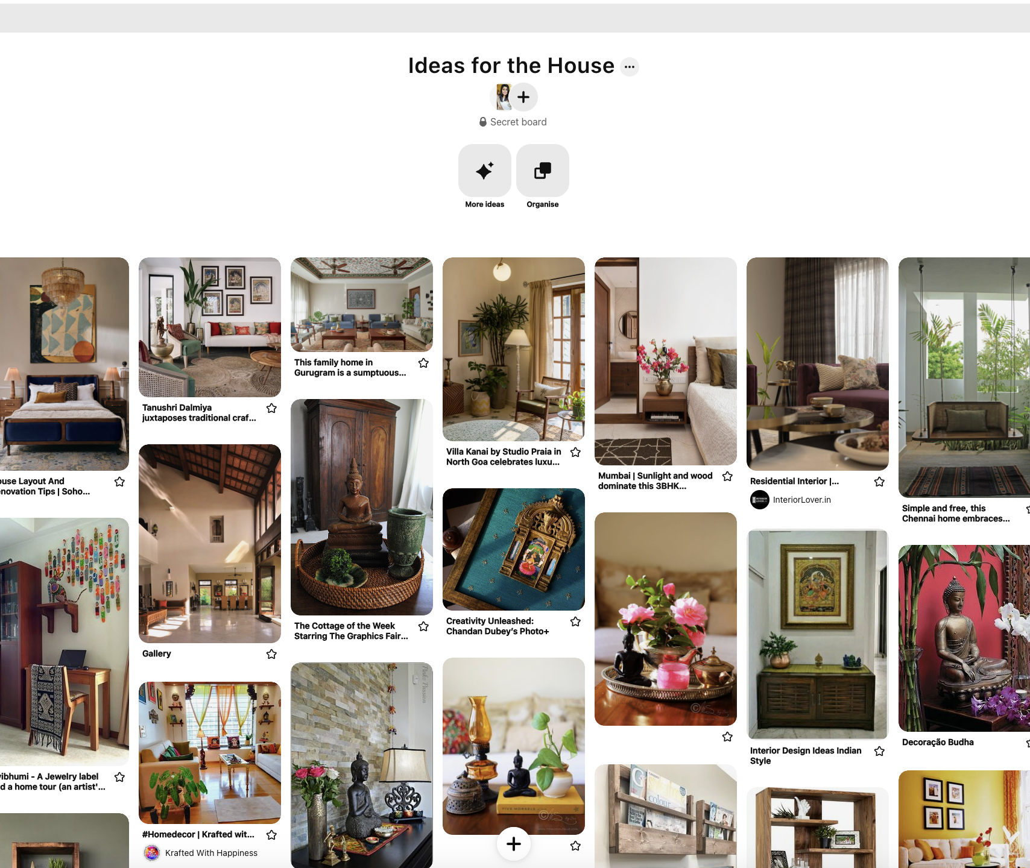
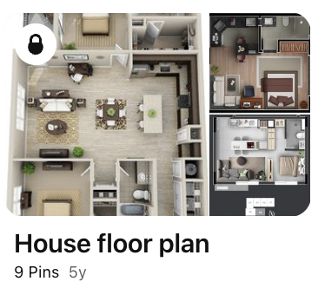
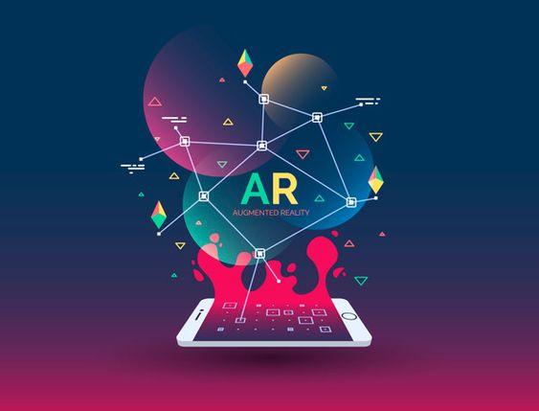

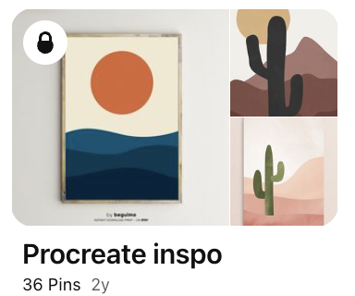


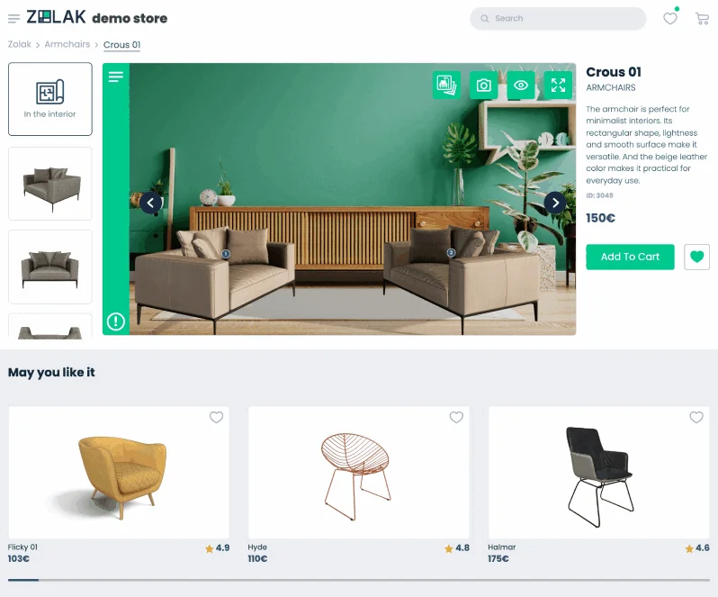
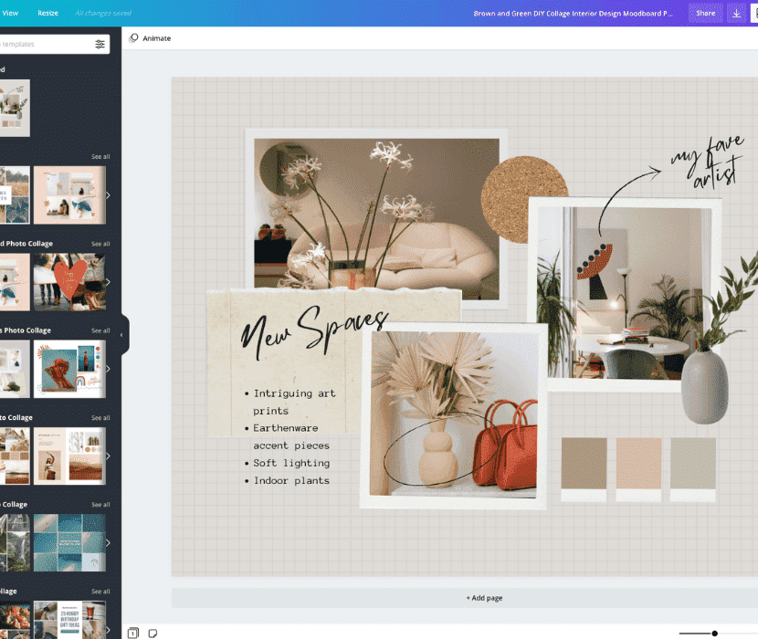

Early Monetization & App Integration
Gen AI
To generate ideas for user needs
Voice controlled sessions
Augmented Reality
How do we do things differently ?
Past & Future
Inbuilt creator mode for a seamless workflow.
More intuitive feature to pin from Instagram/TikTok
Sustainability
Automated Product recommendation & segregation
Personalization
Recommend board purging
Location based recommendation
Take informed decision while navigating through ideas.

